Slide 1
ECE558 Final Project
Distance Alert System
Zhe Lu
Ming Ma

Slide 2
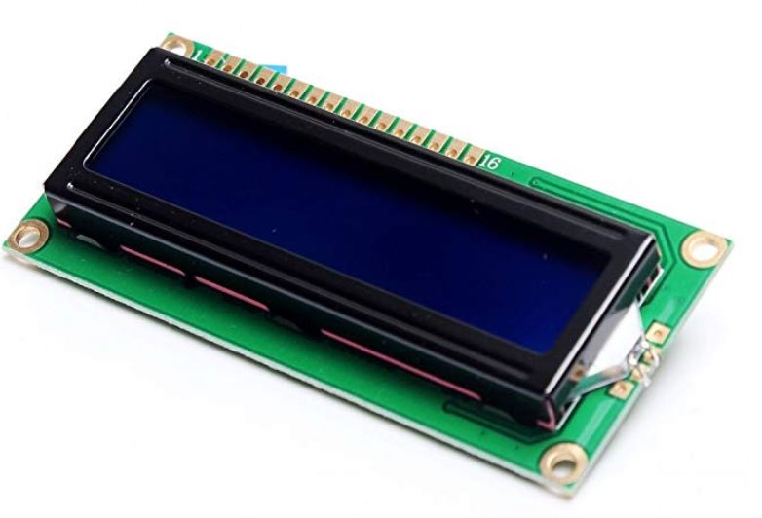
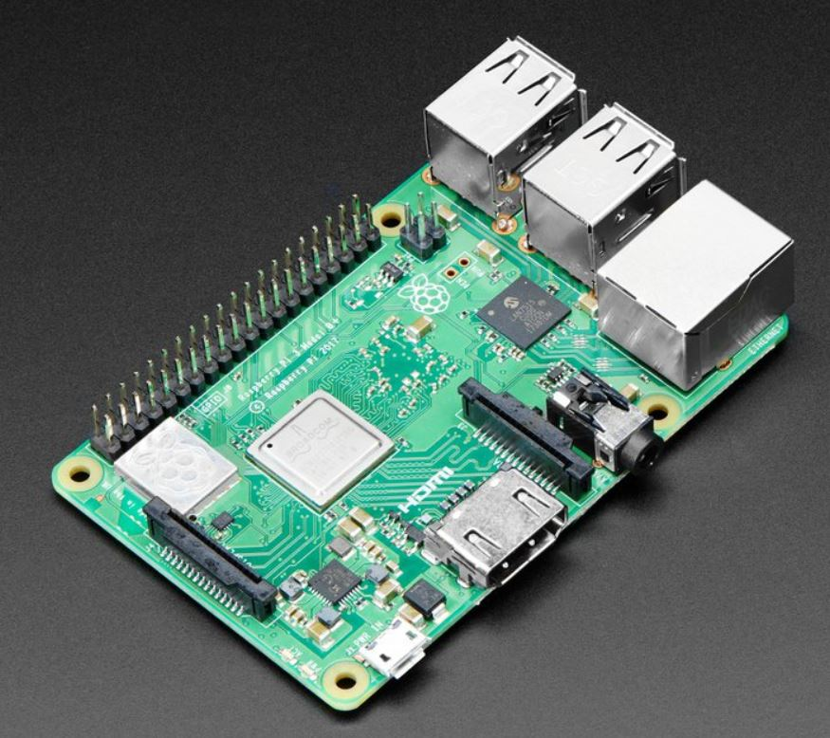
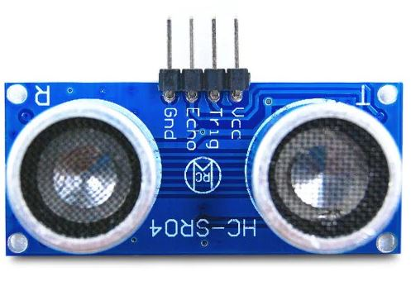
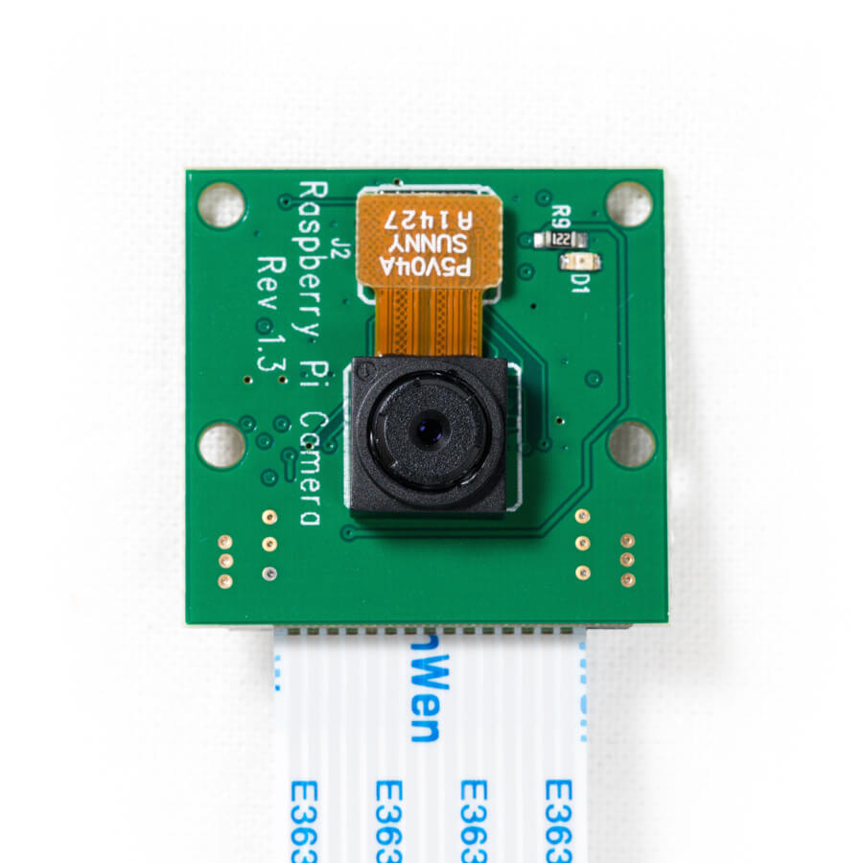
1602 LCD with HD44780
Raspberry Pi 3B
HC-SR04
Calculated Distance
Reflected Signal
Start Point
Firebase Database
10cm < Distance < 15cm
Send pictures
Send pictures
Send Enable Signal to take a picture
App

Slide 3
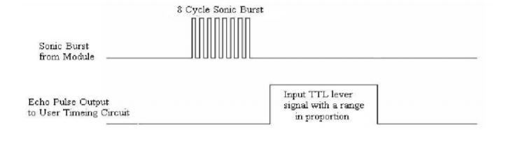
HC-SR04 Distance Sensor
Distance(cm) = ((pulse width in ns)/(10^9)*340/2)*100
Echo-Input; Trig-Output

Slide 4
1602 LCD Display
PI4J Library cannot statically link WirePi since April 2018.
'com.nilhcem.androidthings:driver-lcd1602:0.0.3'
Row0: Distance
Row1: Current Time
With build in HD44780 Controller

Slide 5
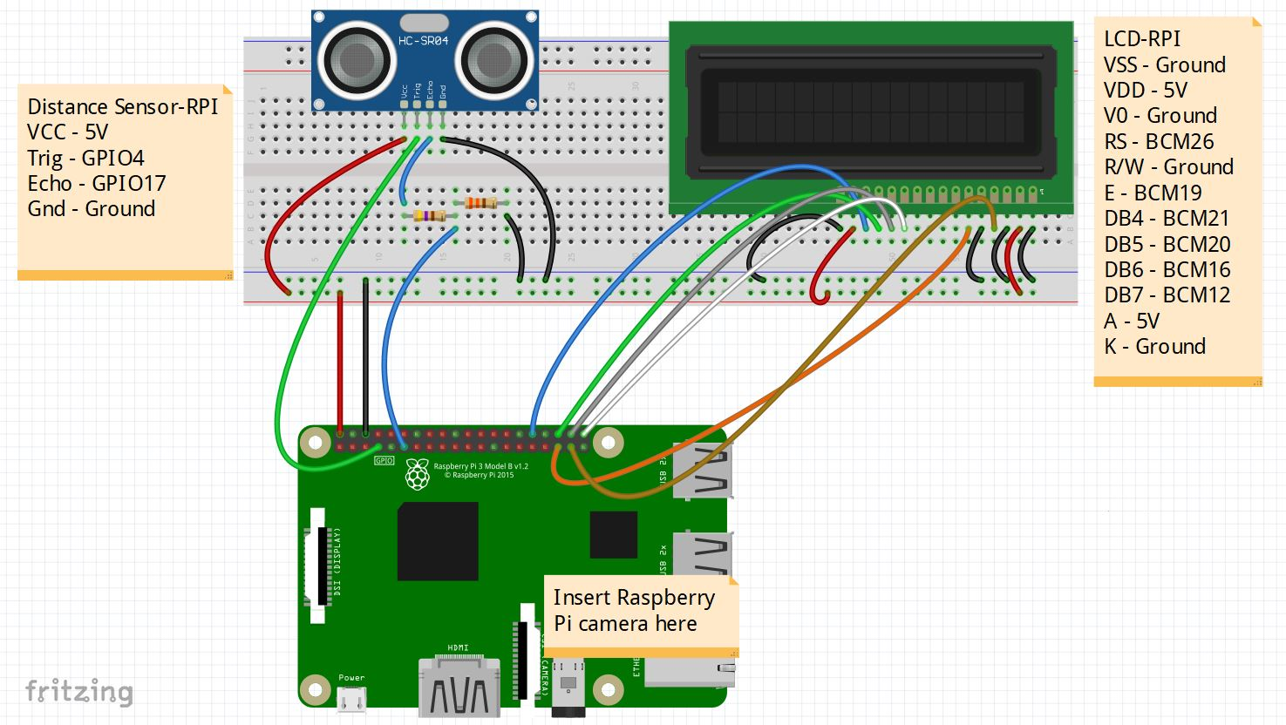

Slide 6

Raspberry Pi Camera

Slide 7
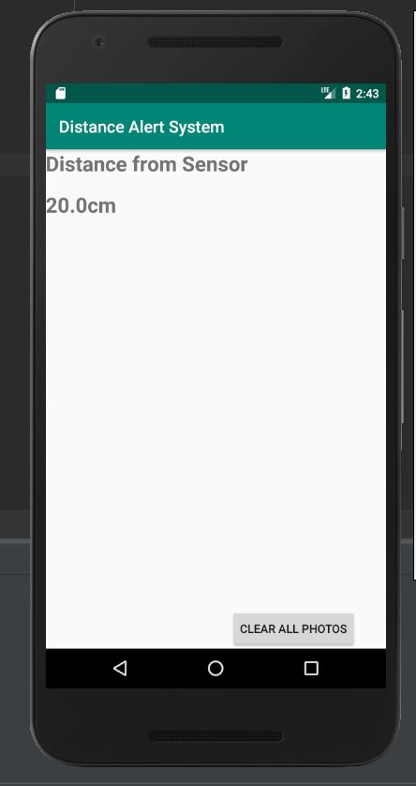
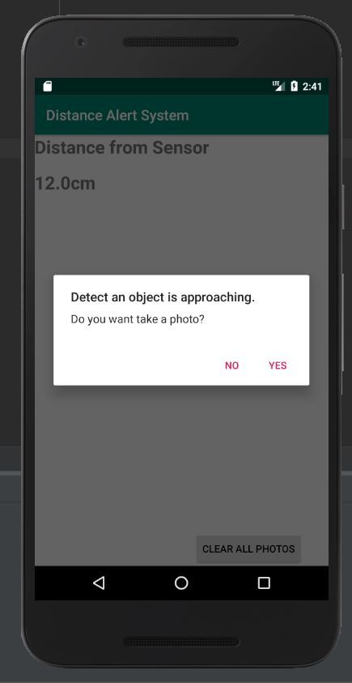
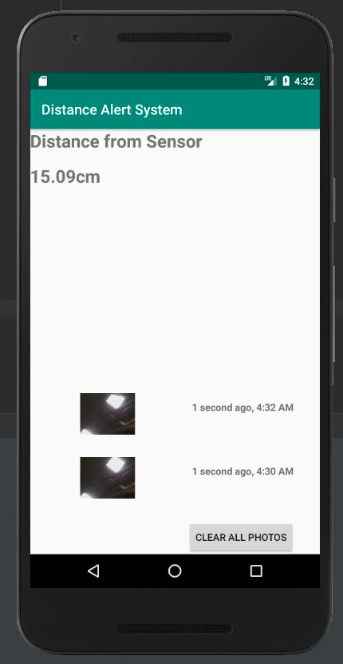
App

Slide 8
Demonstration

Slide 9
Thank You!

